Slide 1
Internet of Things essentials presentation REAL-TIME EARTHQUAKE DETECTOR AND EARLY WARNING SYSTEM
THRILOKE N (210701291)
VAISHNAV KUMAR G (210701297)
UDHAYA KUMAR RJ (210701294)

Slide 2
AGENDA
I. ABSTRACT
II. INTRODUCTION
III. OBJECTIVE
IV. LITERATURE SURVEY
a. KEY CHALLENGES
b. MOTIVATION
V. EXISTING SYSTEM
VI. PROPOSED SYSTEM
VII.MODULES
VIII. SYSTEM ARCHITECTURE
IX. CONCLUSION AND FUTURE ENHANCEMENTS
X. REFERENCES

Slide 3
ABSTRACT
Earthquake threats get smarter detection with a new system using SW420 vibration sensors. These sensors, spread across risky zones, constantly monitor vibrations. Fancy tech sorts real tremors from background noise, reducing false alarms. The system utilizes the Internet of Things (IoT) for real-time communication, sending alerts through a user-friendly interface. In case of a big one, warnings blast out via apps, SMS, emails, and sirens. Faster warnings empower individuals, emergency services, and authorities to take action quicker, like evacuations, rescues, and infrastructure checks. This system also integrates with smart city tech for optimized resource allocation during earthquakes. Designed for affordability and scalability, it enhances earthquake preparedness and public safety. Continuous improvements in sensor technology, data analysis, and communication are crucial for even better performance in the future.

Slide 4
INTRODUCTION
An earthquake detector is a device designed to sense and measure seismic activity, primarily earthquakes. These detectors play a crucial role in monitoring seismic events, providing early warning systems, and studying the behavior of earthquakes.

Slide 5
OBJECTIVE
Rapid and Precise Earthquake Detection.
Minimize False Alarms.
Real-Time Data Communication.
Enhanced Earthquake Detection Accuracy.
Effective Multi-Channel Alerting.
Improved Disaster Response and Preparedness.

Slide 6
LITERATURE SURVEY
Research paper on “A REAL-TIME EARTHQUAKE DETECTOR AND EARLY WARNING SYSTEM”[1] Wu, Y. M., & Kanamori, H. (2008). Development of an earthquake early warning system using real-time strong motion signals. Sensors, 8(1), 1-9.
[2]Nakamura, Y., & Saita, J. (2007). UrEDAS, the earthquake warning system: Today and tomorrow. Earthquake early warning systems, 249-281.
[3]Iervolino, I., Convertito, V., Giorgio, M., Manfredi, G., & Zollo, A. (2006). Real-time risk analysis for hybrid earthquake early warning systems. Journal of Earthquake Engineering, 10(06), 867-885.

Slide 7
[4] Zhang, G., Yang, L., & Jiang, W. (2024). Key technologies of earthquake early warning system for China’s high-speed railway. Railway Sciences, 3(2), 239-262.
[5] Finazzi, F., & Massoda Tchoussi, F. Y. (2024). Assessing the alerting capabilities of the Earthquake Network early warning system in Haiti with Monte Carlo simulations. Stochastic Environmental Research and Risk Assessment, 38(1), 147-156.

Slide 8
KEY CHALLENGES
Sensor Network Deployment and Maintenance.
Data Processing and Accuracy.
Real-Time Communication Reliability.
Public Awareness and Education.
Cybersecurity Threats & System Reliability and Uptime.

Slide 9
MOTIVATION
Since the process of cleaning a fan blade is time and human effort consuming when it comes to places with large number of fans, there might be a tendency to neglect cleaning of fan blades on a consistent basis. In turn, the harms that this ignorance can produce is many times, overseen. A fan blade always carries an uninvited source of dust which might cause a runny nose, itchy throat and various breathing & lung-related complexities. For instance, an unclean fan at a hospital could add to the already existing health impacts of patients with respiratory problems .This motivated us to come up with the idea of an automated ceiling fan blade cleaner.

Slide 10
EXISTING SYSTEM
Earthquake detection traditionally relies on a network of seismic sensors like accelerometers and seismometers. These sensors continuously measure ground motion, and sophisticated algorithms process this data to identify earthquakes. Techniques like filtering and waveform analysis help distinguish real tremors from background noise. Once an earthquake is detected, the system estimates its location, depth, magnitude, and timing. This crucial information is then delivered through alerts via mobile apps, sirens, and other channels, allowing individuals and authorities to take action like evacuations or infrastructure checks.

Slide 11
PROPOSED SOLUTION
The system uses four SW420 sensors and a microcontroller to monitor vibrations. It analyzes data to detect earthquakes and reduce false alarms. Upon detection, an alarm sounds and alerts (SMS, email) are sent. Users should have a plan (shelter, evacuation) for these alerts. Regular testing and maintenance ensure reliable operation.
Advantages:
Lifesaving Seconds.
Empowered Response & Reduced Damage.
Enhanced Preparedness & Cost-Effective Mitigation.

Slide 12
MODULES
SW420 Vibration Sensor.
ESP32 DEV module.
Alert message using IOT(blynk app).
Buzzer.
Bread Board.

Slide 13
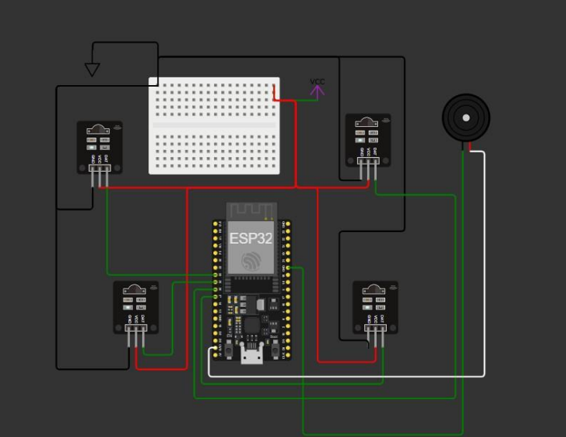
CONNECTION DIAGRAM

Slide 14
CONCLUSION
The real-time earthquake detection system utilizing SW420 vibration sensors, integrated with the Blynk app for alerting via push notifications and a buzzer for local alerts, presents a promising solution for timely earthquake monitoring and warning. Through our experimentation and testing, we have demonstrated the effectiveness of the system in detecting seismic activity and providing alerts to users, both locally and remotely. The integration of multiple sensors enhances the coverage area and improves the accuracy of earthquake detection. Additionally, the user-friendly interface of the Blynk app facilitates ease of use and customization, enhancing user experience.

Slide 15
FUTURE ENHANCEMENTS
Further optimization of sensor placement, calibration, and signal processing algorithms can improve the sensitivity and accuracy of earthquake detection, reducing false alarms and improving detection reliability.Integration of advanced seismic sensors, such as accelerometers and MEMS sensors, can enhance the detection capabilities of the system, allowing for more precise monitoring of seismic activity.Exploration of machine learning techniques for seismic signal analysis and pattern recognition can improve the system's ability to distinguish between genuine seismic events and noise, enhancing detection performance. Implementation of cloud-based data analytics and real-time data processing can enable advanced analytics, trend analysis, and predictive modeling, providing insights into seismic activity patterns and facilitating early warning systems.

Slide 16
REFERENCES
[1] Wu, Y. M., & Kanamori, H. (2008). Development of an earthquake early warning system using real-time strong motion signals. Sensors, 8(1), 1-9.
[2]Nakamura, Y., & Saita, J. (2007). UrEDAS, the earthquake warning system: Today and tomorrow. Earthquake early warning systems, 249-281.
[3]Iervolino, I., Convertito, V., Giorgio, M., Manfredi, G., & Zollo, A. (2006). Real-time risk analysis for hybrid earthquake early warning systems. Journal of Earthquake Engineering, 10(06), 867-885.
[4] Zhang, G., Yang, L., & Jiang, W. (2024). Key technologies of earthquake early warning system for China’s high-speed railway. Railway Sciences, 3(2), 239-262.
[5] Finazzi, F., & Massoda Tchoussi, F. Y. (2024). Assessing the alerting capabilities of the Earthquake Network early warning system in Haiti with Monte Carlo simulations. Stochastic Environmental Research and Risk Assessment, 38(1), 147-156.

